Slide 1
University/College/ scholarship Presentation
October, 2020

Slide 2

Welcome Graduating class of 2021!

Slide 3



The Final Year….. No Regrets!
Are you stressed?
Not sure what to apply for?
Busy with studying, virtual school visits, and work etc etc??

Slide 4




Some Thoughts:
Keep Organized!!
RESEARCH and plan visits!
Work hard – you could be 1% away from a scholarship or spot that you didn’t get. We don’t change marks after the fact! Earn them now.
Develop strong relationships with teachers and Guidance
If you need a teacher reference letter, give teachers lots of time to complete it!
Don’t leave things until the last minute ie. community hours, supplemental applications etc. etc.

Slide 5
New grade 12 Guidance google classroom!
Hopefully you have joined by now! Class code jzkcwls
We will be posting LOTS of information here:
  Community Involvement opportunities and updates!!! As of now you need your 40 hours!!
  Application information,
  Important Dates and reminders,
  Virtual Tours and sessions
  all power points.
Check regularly for information!!

Slide 6
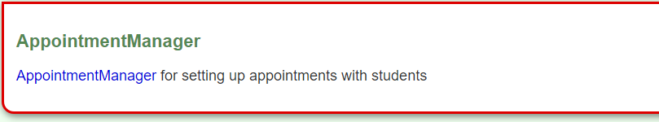
How to connect with Guidance this year!
To drop/change courses – Google forms on Google Classroom
To do/ask anything else:
Make an appointment on teach assist on APPOINTMENT MANAGER for:
A google meet
An email or phone conversation

Slide 7
This year…..
Ontario University and College in person Fairs are cancelled.
All tours and sessions are virtual until further notice!
Check the schedule posted on the Guidance Google classroom.

Slide 8

How much will this cost and where do I get the money???

Slide 9
Approximate Cost of University and college!
University:
Living at home:
Tuition - $7000 - $9000 per year = $32 000 for 4 years
Living away:
Tuition - $7000 - $9000 per year
Residence + Food =$13 000 = $20 000 per year or $80 000 for 4 years
College:
Living at home:
Tuition - $2400 per year x 3 years = $7200 for 3 years
Living away:
Tuition - $7200 + residence for 3 years = $12,000 = about $20,000 for 3 years

Slide 10
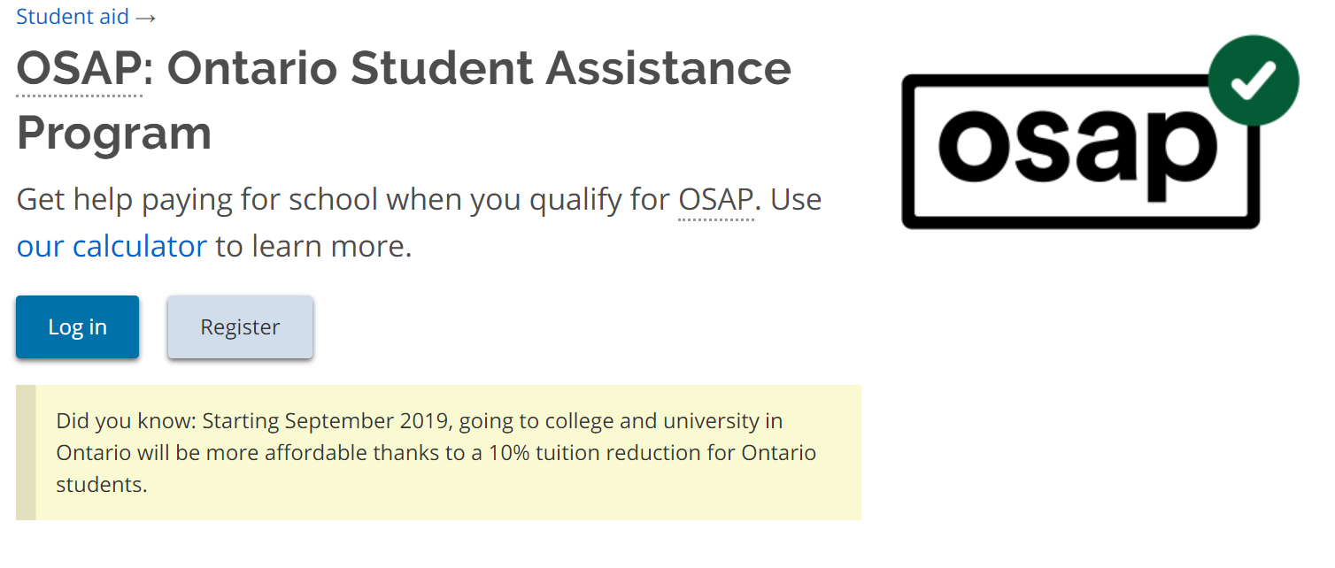

Slide 11
OSAP
There is no rush on applying for OSAP
Usually applied for in April – June as you have to tell them the school you have been accepted to.
You can apply later as well, but the funds may not be available when the tuition is due.
There is an OSAP Aid Estimator you can do now to see how much you may be eligible for!

Slide 12
Scholarships
Automatic Scholarships – Apply to a school with a good average and you could be offered a scholarship with your offer of Admission
Most Scholarships you have to apply to and research!!

Slide 13

Do Your Scholarship Research NOW!
University bound students research www.ontariouniversitiesinfo.ca and go to the finance tab.

Slide 14
Where to Look for Scholarships $$$
Pick up the list of websites in Guidance
Check the Scholarship Bulletin Board near Guidance
Research, research, research
Create a personal profile at www.studentawards.com or scholartree.ca – you will receive e-mails
Check other websites:
  www.canlearn.ca
  www.scholarshipscanada.ca
  www.osca.ca
  yconic.ca
  www.fundyourfuture.ca
  www.ontrasfer.ca
  www.servicescanada.gc.ca
  www.ontariouniversitiesinfo.ca (university)

Slide 15
University timelines and admission

Slide 16
University info Review:
Universities require 6 grade 12 U and/or M level courses for admission.(check your specific program to see how many M courses are allowed.)
CO-Op credits will not count for University admission.

Slide 17
Review your credit summary!
New this year!
Your Credit Counselling Summary may be emailed out to you for review if the YRDSB can do it in time.
Check carefully for requirements to graduate and program requirements.
Other requirements you need to check are:
  Community Hours completed?
  Literacy test completed
  6 U/M courses if applying to University
  30 credits (18 compulsory and 12 elective)

Slide 18
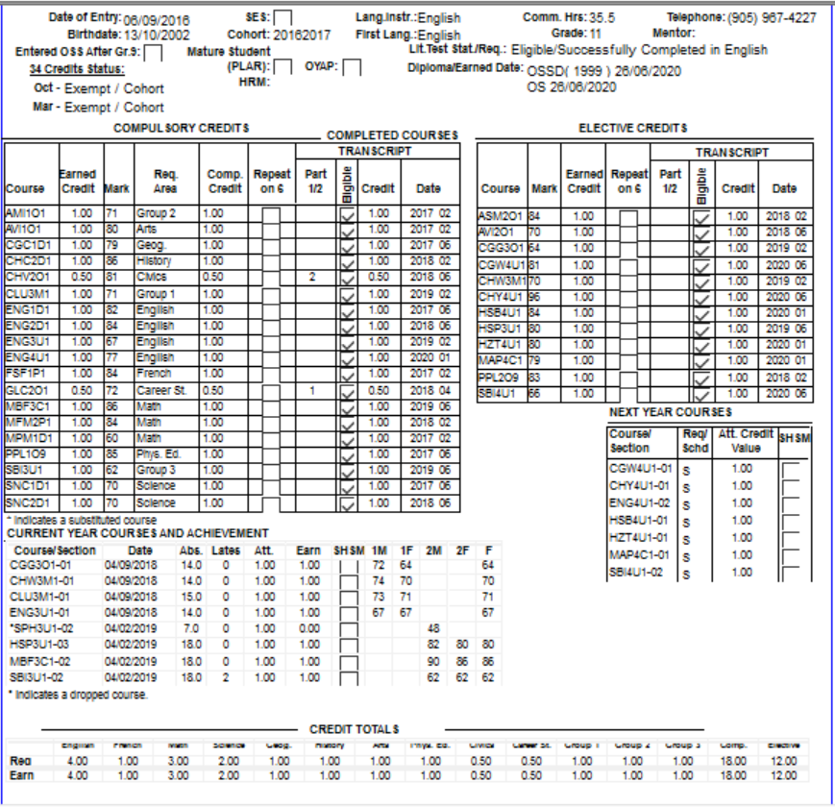
Final Check of CCS
Community Involvement hours?
Literacy test completed?
6 U/M Courses for University?
30 credits total?

Slide 19
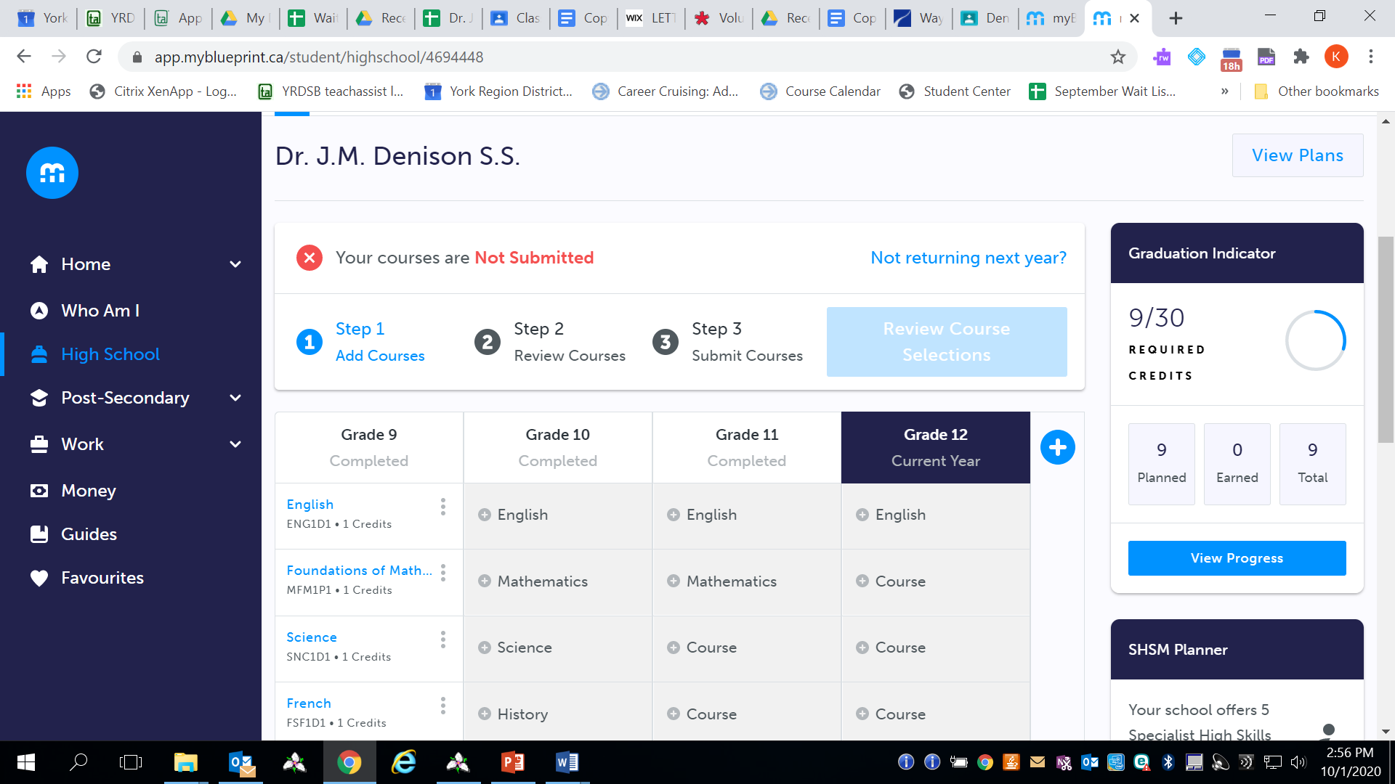
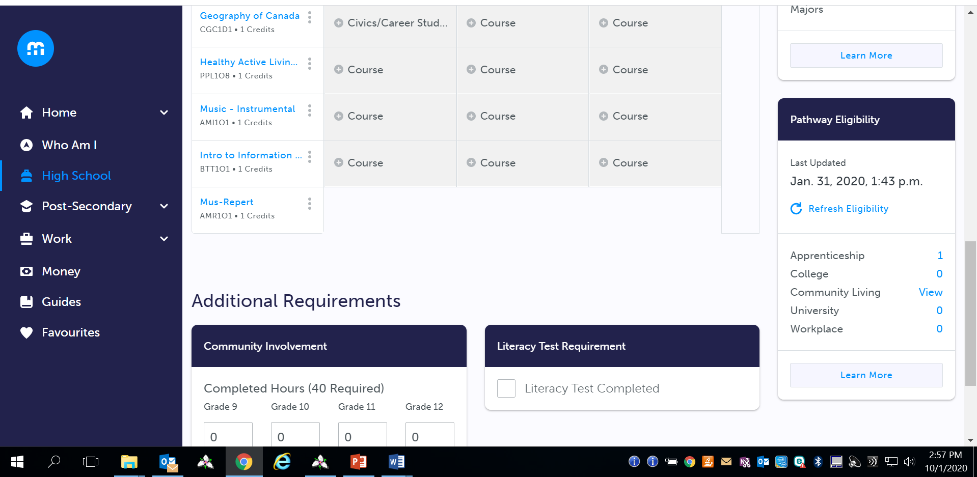
Check your Pathway Planner/My Blueprint to make sure you have all of your requirements:
  Hours
  Literacy test/course
  6 – U/M course if applying to University
  30 credits total

Slide 20
Courses from Private school, other boards, ILC etc. won’t automatically come to us. LET US KNOW PLEASE!!!
Grade 11 marks are used to provide information about you but marks cannot be used in your final admission average.
You could get an earlier offer if your grade 11 marks and/or semester 1 grade 12 mid terms and final marks are good

Slide 21
Timelines:
October is when student University PIN Numbers and Passwords will be distributed to students. NEW THIS YEAR- they will be sent out to ALL YRDSB students from the same day- OCTOBER 29, 2020
This allows you to apply online from that point until the deadline January 15.( We recommend that all students SHOULD apply by December to avoid backlog of applications)
May 27, Universities must respond.
June 1, You must respond!!!!

Slide 22
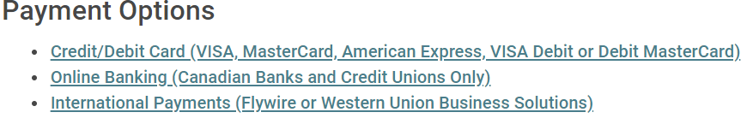
Details:
The cost is $150 to apply to 3 universities
You may apply to more than 3 universities at a cost of $50.00 each
Students will be able to verify and change information on their application independently, as well as check their status on line.

Slide 23
Research!!!!!
Use www.ontariouniversitiesinfo.ca to research programs, prerequisites, and marks to get into your chosen programs.

Slide 24
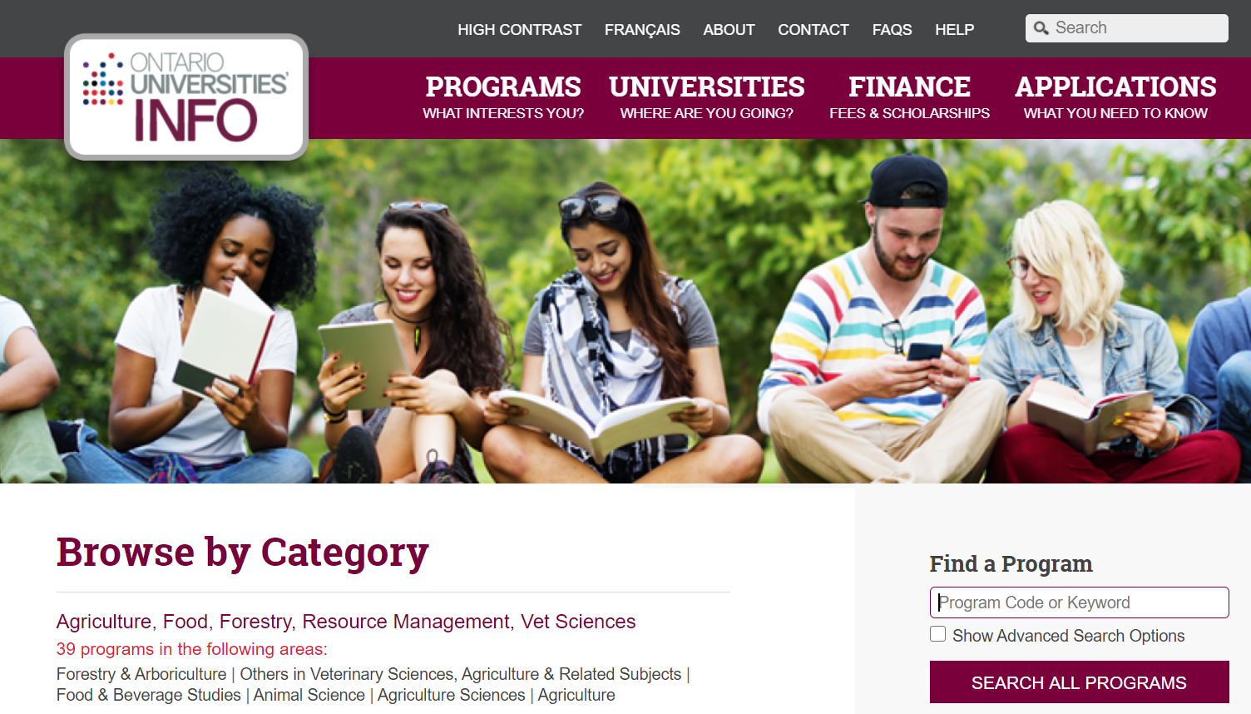
Ontario University research

Slide 25
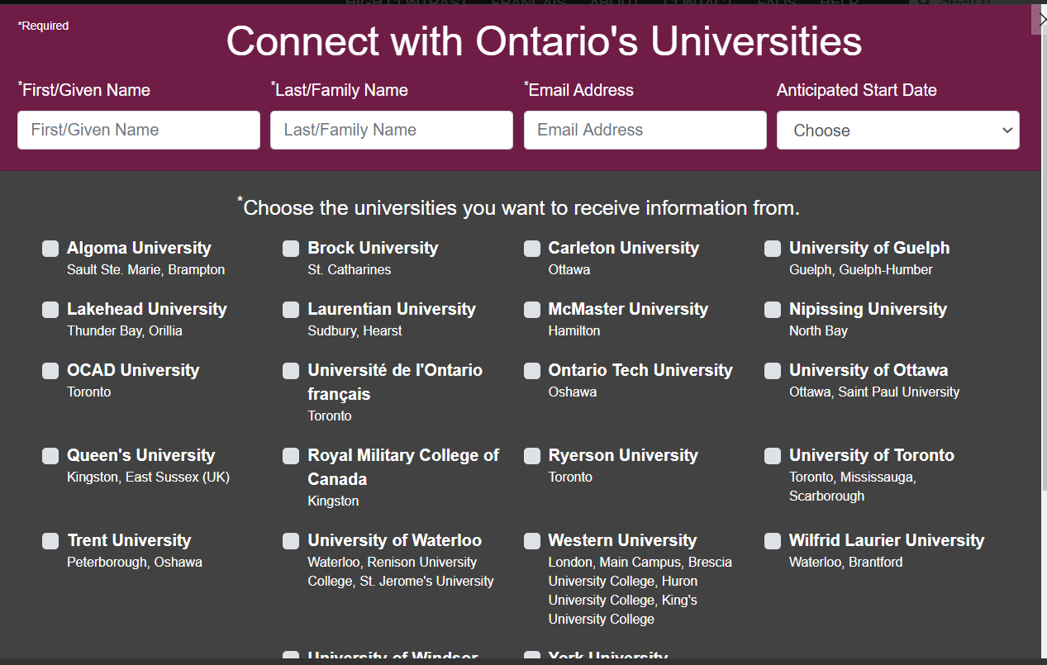
New this year!
Pick specific schools and they will start emailing you information!

Slide 26

Ryerson’s sport media Program

Slide 27
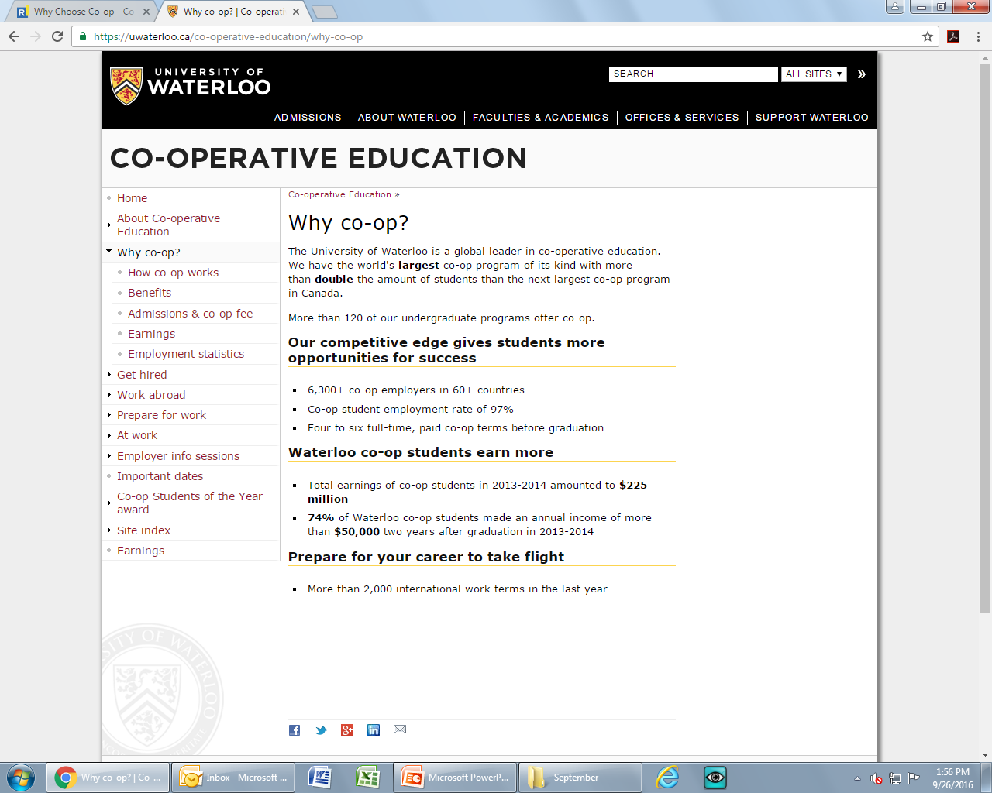
Co –op Experiences!

Slide 28
Once I have decided on a program do I have to do anything else?
Some programs – no…….they are mark based and we transmit marks
Other programs – Yes!!! ….supplemental or profile forms are necessary and VERY important.
They should be emailing you additional things you have to do so KEEP CHECKING YOUR EMAIL!!!

Slide 29
Other Opportunities:
4 year DEGREE PROGRAMS are available at Ontario Colleges! Eg. Bachelor of Applied Business in Financial Services Management at Seneca
Many Universities and Colleges offer “Joint/Collaborative” Programs Eg. University of Toronto and Centennial- Paramedicine and Journalism programs.
Guelph and Humber -Honours Bachelor of Applied Science in Justice Studies (BASc) and Diploma in Police Foundations or Community & Justice Services
.York and Seneca -Broadcasting (BA in Communication Arts/ Diploma in Radio or Television Broadcasting)

Slide 30
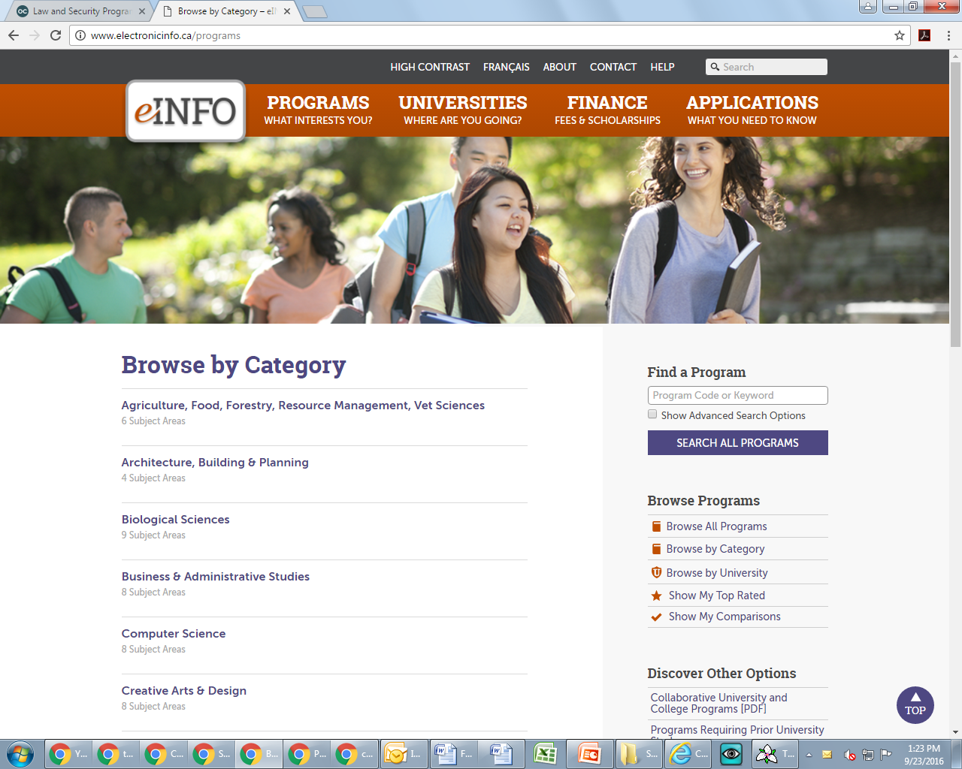

Slide 31
Schools outside of Ontario
Most apply directly to school on website ie. UBC
May need a transcript from Guidance or will link to OUAC/OCAS
US – May require the COMMON APPLICATION AND WRITING SAT’S.
Book a guidance appointment.

Slide 32
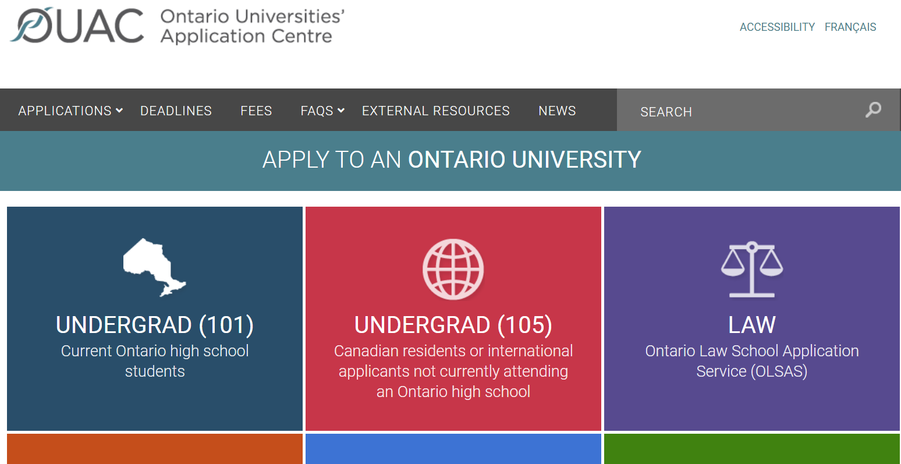
Once the research is finished and you have your PIN number….
Oct – December: Go to www.ouac.on.ca

Slide 33
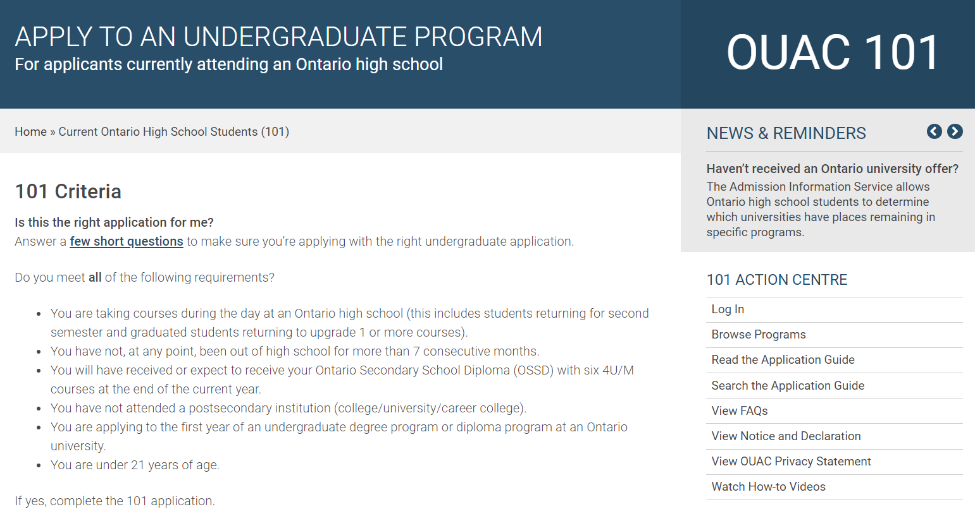

Slide 34
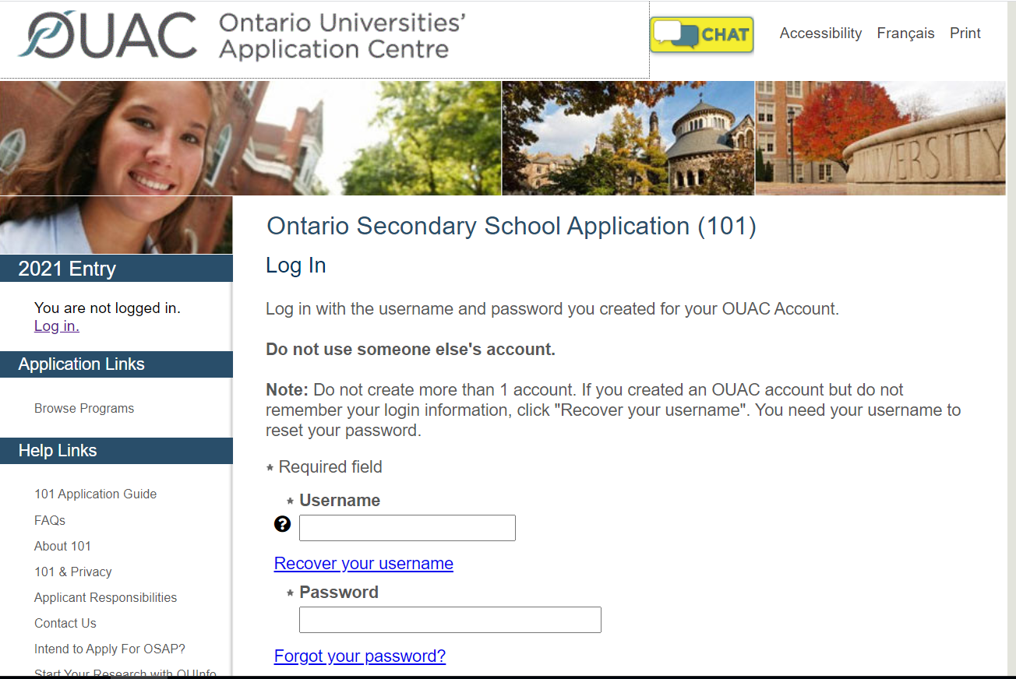

Slide 35
Final Thoughts…..
Start your research!!
Visit virtual campuses and information sessions
Keep track of your DATES for applications and supplemental requirements
Check your EMAILS regularly
Book Guidance appointments if unsure or you have questions!

